Slide 1
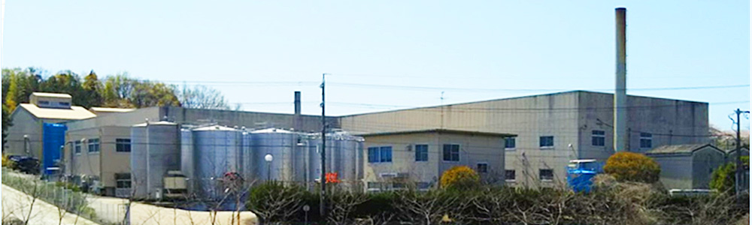
About AICHI KEISO Co.,Ltd.
© 2023 AICHIKEISO Co.,Ltd.
Since our establishment in 1932, we have been manufacturing and selling
sodium silicate as our main product.
We now handle a variety of derivative products and many functional materials
such as deodorizers made from sodium silicate.
We prove worthy of the customer trust by the correspondence
only by the specialty maker of sodium silicate.

Slide 2
Company Overview
© 2023 AICHIKEISO Co.,Ltd.
Corporate name | AICHI KEISO Co.,Ltd.
URL | http://www.aichikeiso.co.jp
E-mail | keiso@aichikeiso.co.jp
Location | 92-2,Bogane-cho,Seto,Aichi 489-0979 JAPAN Tel +81-561-83-8711 Facsimile +81-561-83-0561
Founded | 1932（Aichikeiso seizojyo）
Established | 1965.01.14
Capital | 48 million yen
Board members | Representative Director Yo Kato Managing Director Shunji Kato Director Yoshiko Kato Auditor Mineko Miyachi
Financial institutions | Seto Shinkin Bank, MUFG Bank, Ltd.
Affiliated company | Aichi Shizai Co.,Ltd. 92-2,Bogane-cho,Seto,Aichi 489-0979 JAPAN Tel +81-561-83-8844 Facsimile +81-561-83-8845

Slide 3
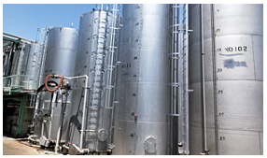
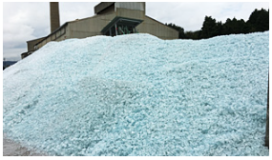
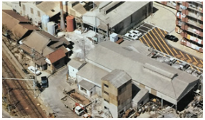
Our Strengths
© 2023 AICHIKEISO Co.,Ltd.
AICHIKEISO Co.,Ltd. is one of the leading manufacturers of sodium silicate in Japan. We also supply special products on a trial basis to meet our customers' needs.
Our factory is located in the vicinity of a silica sand production area, which is the raw material for our products. We are able to provide a stable supply because we handle the entire process from raw material procurement to manufacturing.
Since our establishment in 1932, we have been delivering our products to many companies and have earned their trust. We will continue to make progress by developing new products.

Slide 4
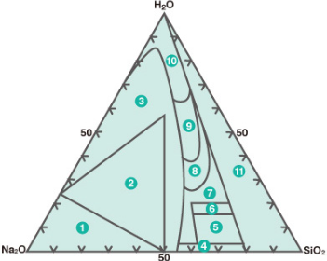
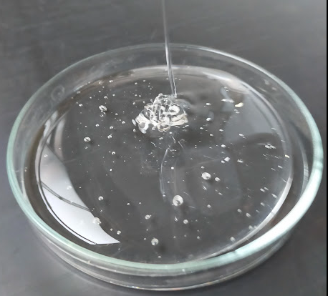
About sodium silicate
© 2023 AICHIKEISO Co.,Ltd.
A highly concentrated aqueous solution of sodium silicate is a viscous,
clear liquid, also known as water glass.
Water glass is expressed by the composition formula
Na₂O・nSiO₂・xH₂O, where the value of n in the composition
formula indicates the molar ratio of SiO₂/Na₂O.
We commercialize water glasses with various molar ratios.
Because of its unique properties, water glass is used in a variety
of applications, including as a soil hardener for civil engineering,
an additive for soap, a chemical for recycling waste paper,
and a synthetic raw material for silica gel and zeolite.

Slide 5
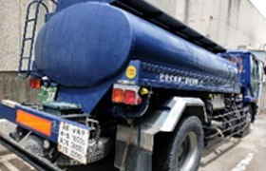
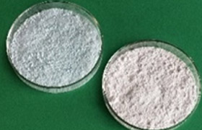
Products
© 2023 AICHIKEISO Co.,Ltd.
Sodium silicate
Potassium silicate
Colloidal silica
Inorganic deodorizers ”SURFSORB”
Inorganic antibacterial agents ”SilicaJoin”
Photocatalytic powder ”SILICATITANIA B”

Slide 6
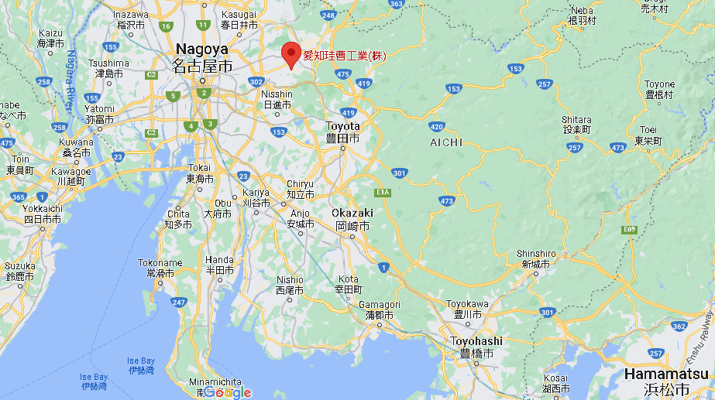
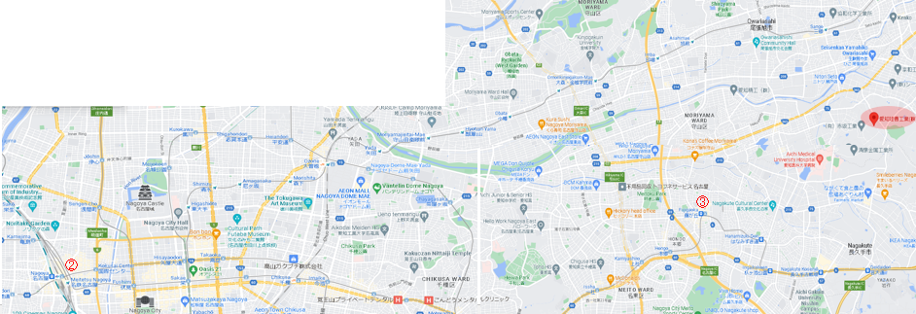
Access
© 2023 AICHIKEISO Co.,Ltd.
Route
Central Japan International Airport^{①} ← Meitetsu Airport Line/about 40 min → Nagoya Station^{②}
← subway Higashiyama Line/about 30 min → Fujigaoka ^{③}← Taxy/about 10min → AICHIKEISO
①

